Slide 1

DEFIRE
"Resilient To Fire"
NASA Space Apps Challenge – Biratnagar
Team: Fire Fighter(Suraj Jha)

Slide 2
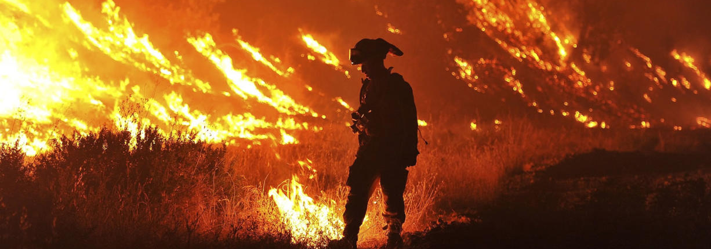
340 Deaths From Fire in UK In 2017.

Slide 3
Main Reasons for the casualties:
Lack of connectivity.
Error in communication.
Wrong navigation.
Lack of fire extinguishing agents.

Slide 4
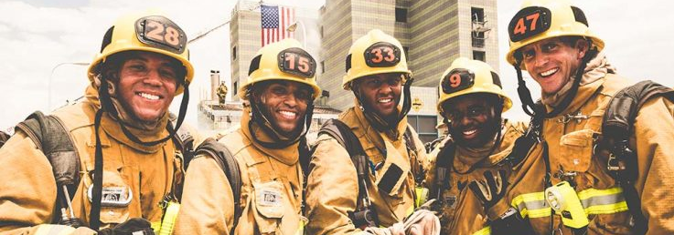
Defire As A System To Empower Less Local Fire Casualties Through IoT & Web Application.

Slide 5
Features of defire:
Web application for user to report fire.
IoT device to report user on fire.
Pin pointing watersheds for firetruck refills.
IoT device on the firefighter for emergency reporting.

Slide 6
Web Application details:

Slide 7
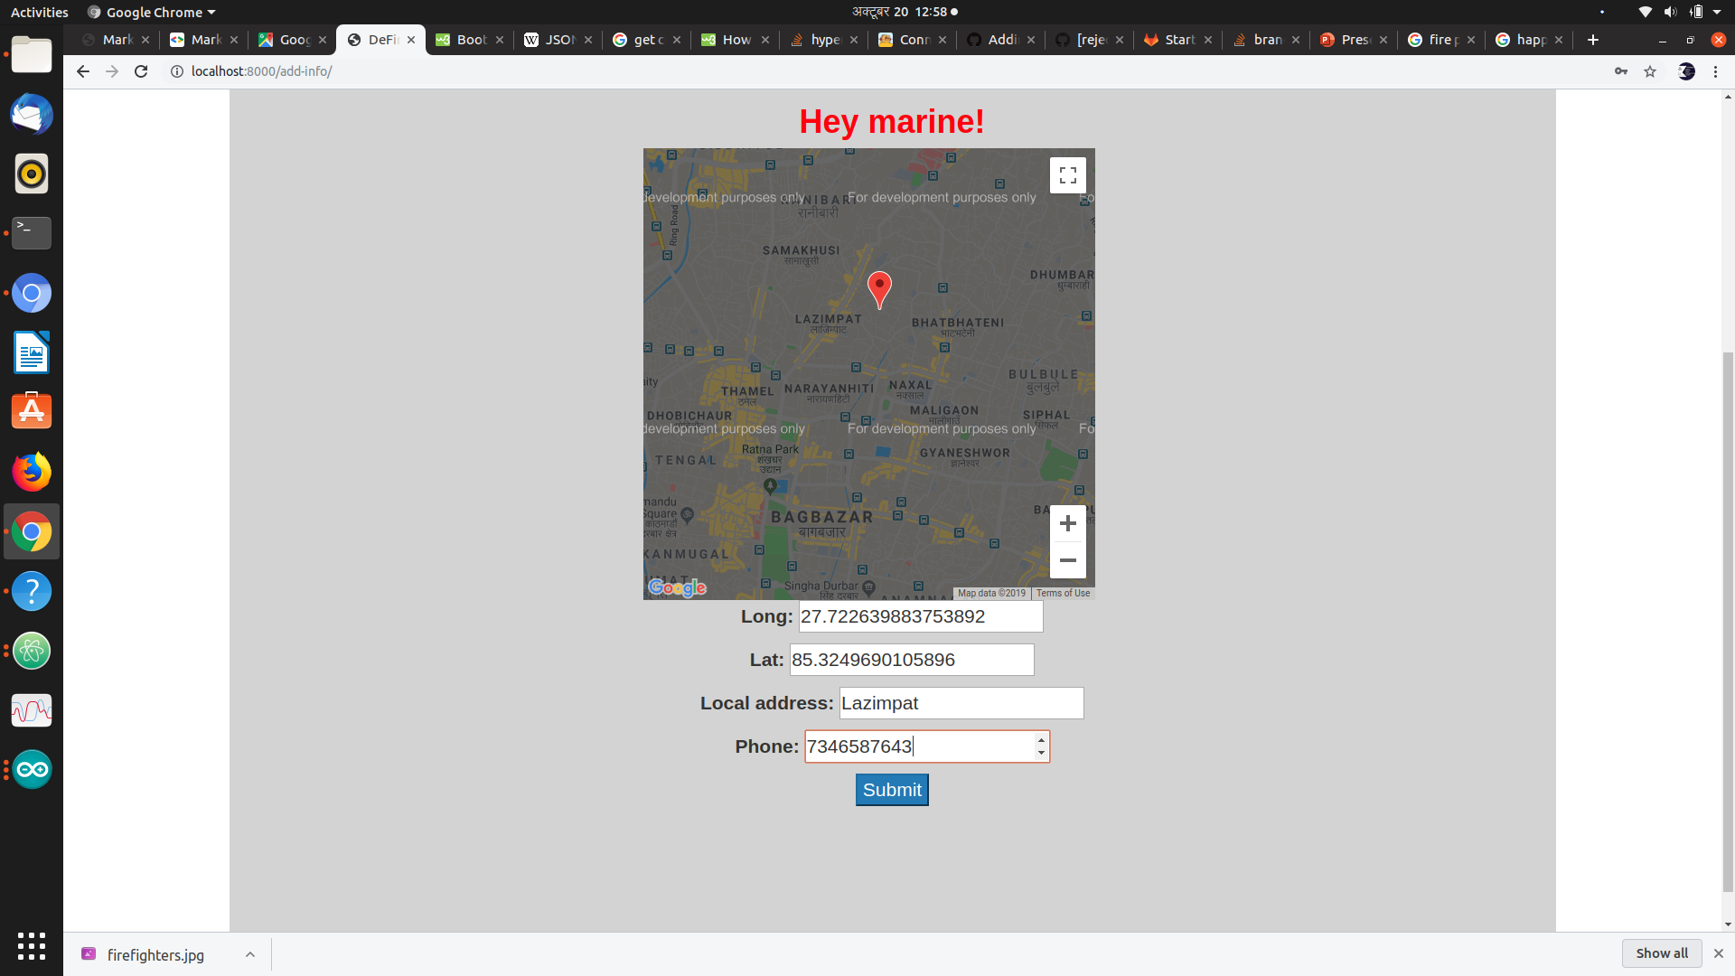
Exact pin pointing of the Address on sign up

Slide 8
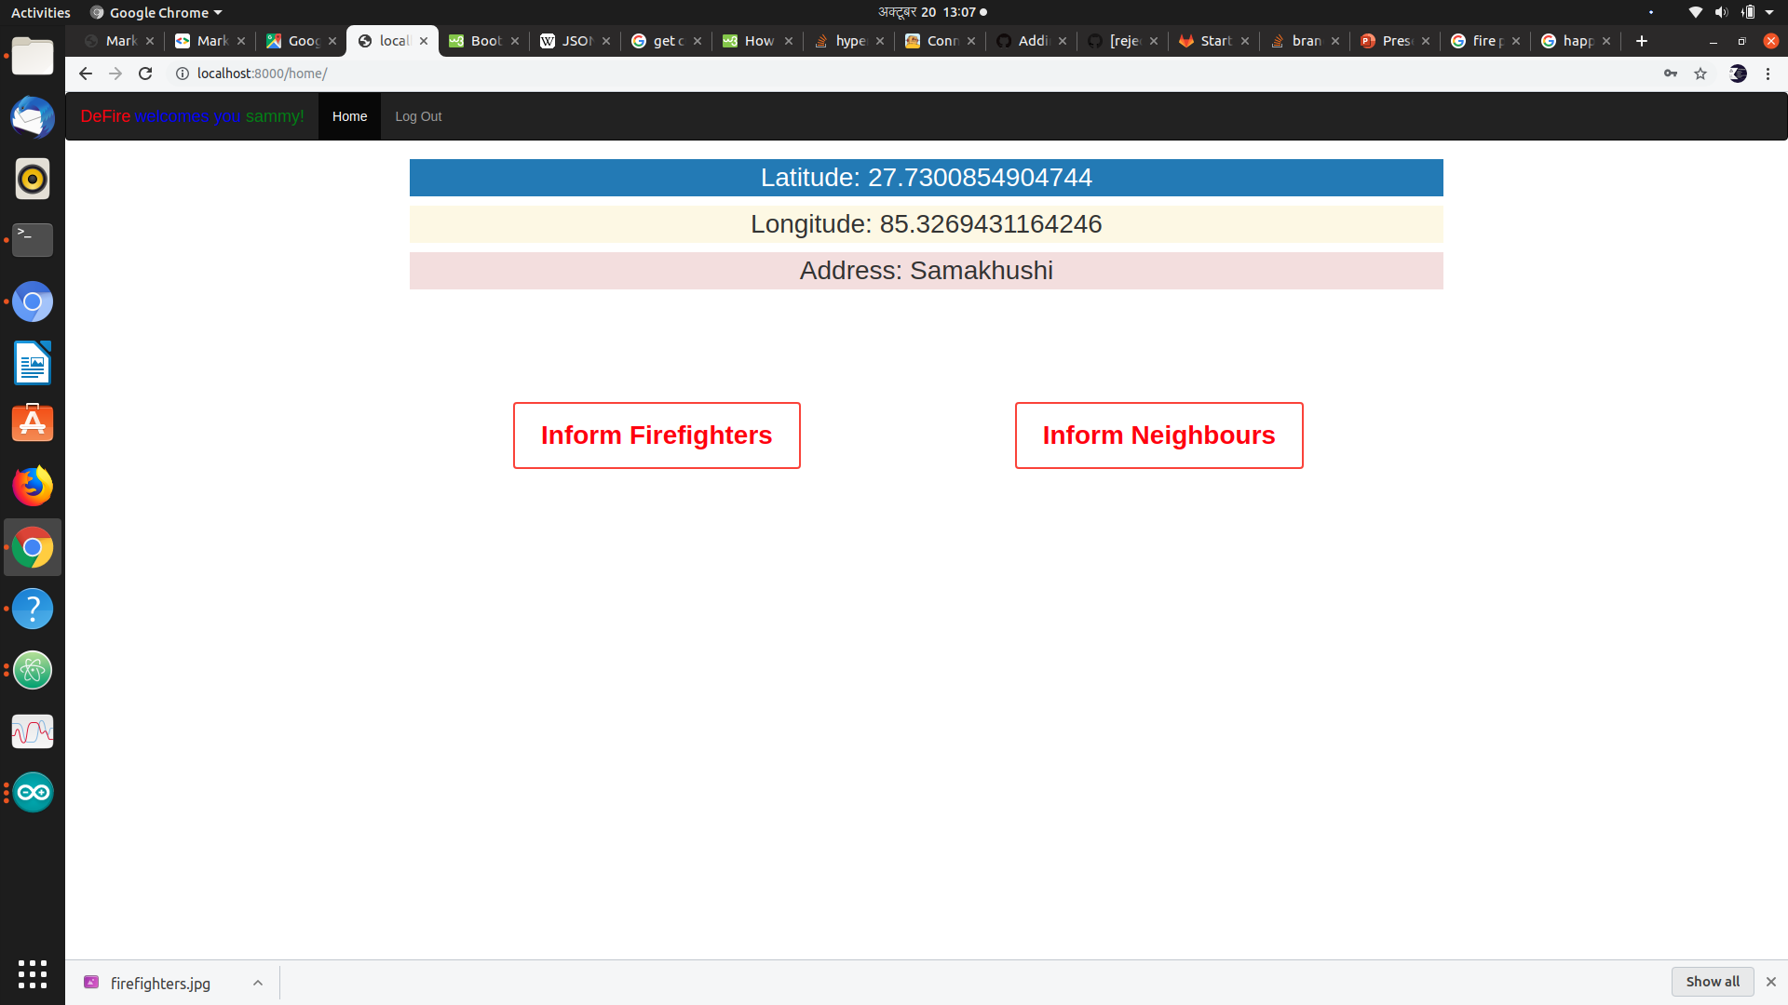
Use the Address to send message to neighbors and Fire Department on Emergency.

Slide 9
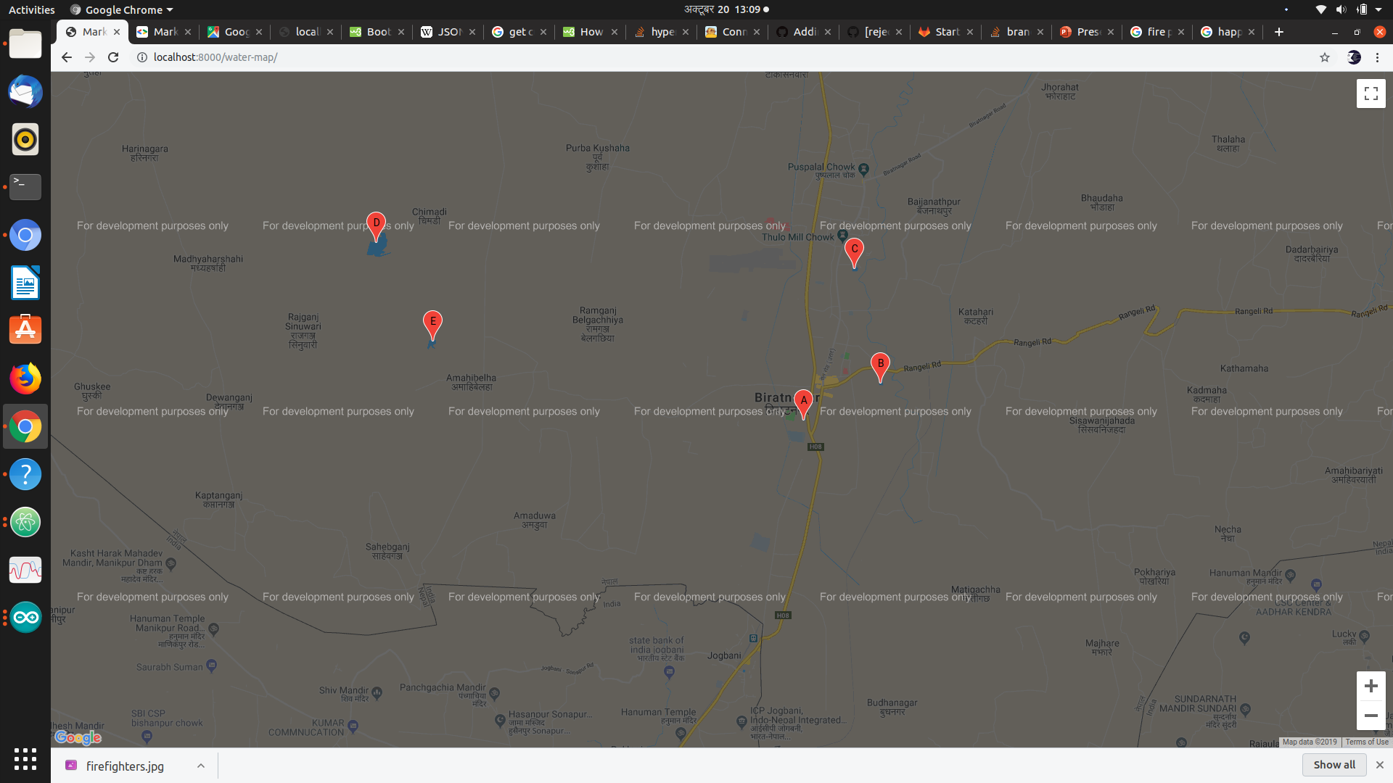
SHow the watersheds to Fire fighters for emergency refill.

Slide 10
Iot device details:

Slide 11
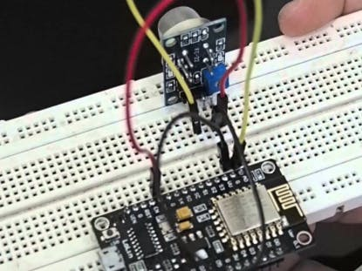
Use different sensors to detect fire in house and report user, authority and neighbors

Slide 12
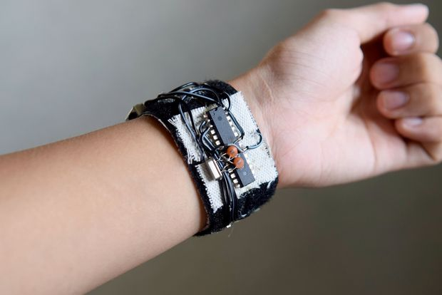
Detection of critical variables with wearable iot device & reporting authority when fire fighter in Emergency.

Slide 13
Let's take fire casualties to minimum. (Thanks)

